Slide 1
Data processing and graph visualisation of tumour and t-cell detections
Yannis laaroussi
Bachelor thesis – Final presentation

Slide 2
Content
Data processing (conversions between data type)
Visualisation (GUI, display graph on an image)
Data processing
Initial Data
New
Data
Linda’s data processing pipeline
New
Data
Visualisation

Slide 3
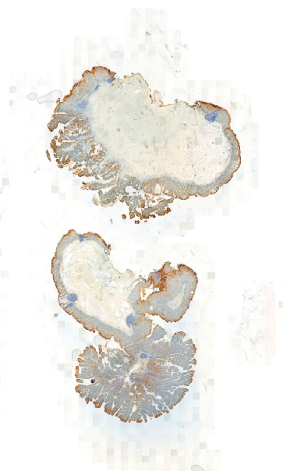
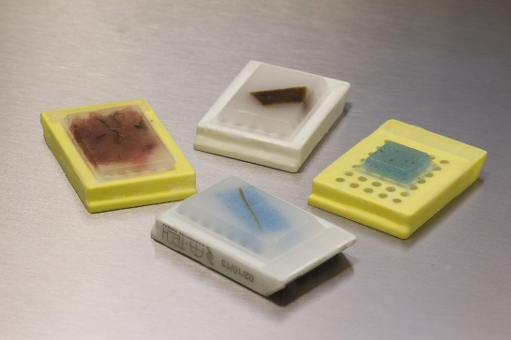
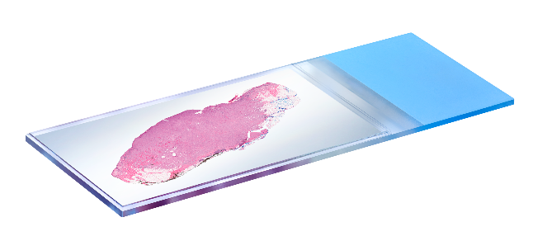
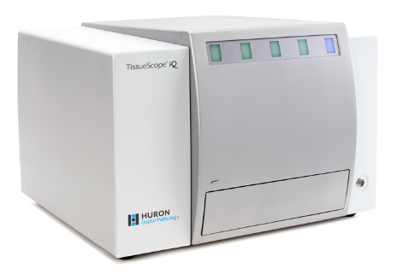
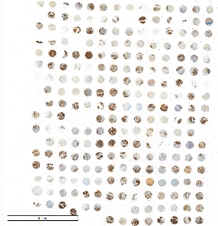
Dataset overview
Interested data
(images)
Paraffin blocks¹
Tiny slides²
Scanner³
cut
send
digitize
1. https://www.biochain.com/blog/what-is-ffpe-tissue-and-what-are-its-uses/ 2. https://www.hurondigitalpathology.com/ 3. https://www.hurondigitalpathology.com/tissuescope-iq-2/

Slide 4
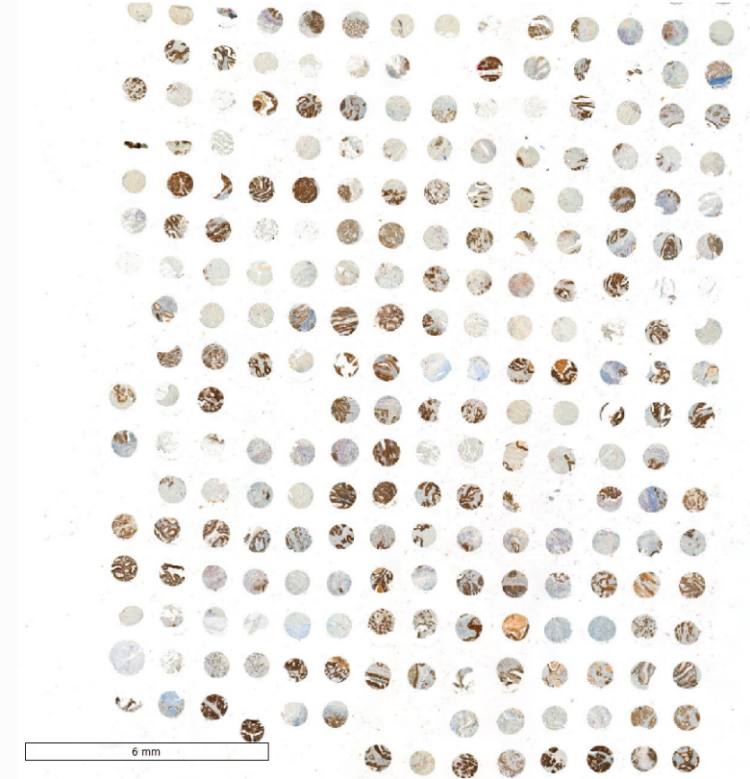
Different types of image
Whole slide image
MRXS type
90’000 - 120’000 pixels
Tissue micro array (TMA)
MRXS type
90’000 - 120’000 pixels
Contains many area of interests

Slide 5
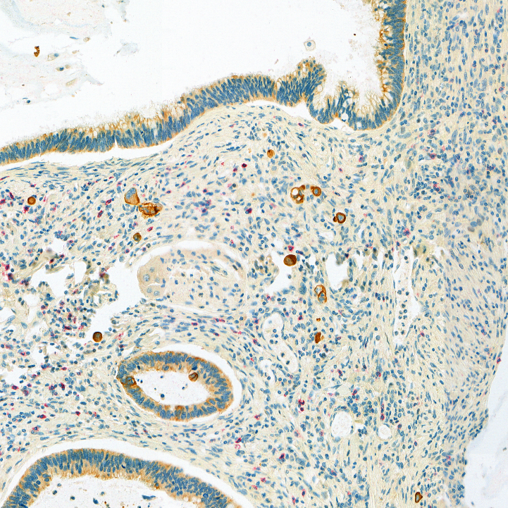
Hotspot image
Tumor budding hotspot
PNG type
~340 images
3600 x 3600 pixels
JSON file associated
Area
Center of mass
Centroid
Circularity
Classification
Solidity
Min/max Diameter
Number of cells
Object index (ID)
ROI points

Slide 6
Open images
2 softwares:
QuPath
ASAP
+ Suitable for processing (a lot of) hotspot images
+ Holds features (area, centroid, circularity, …)
- Slower to process MRXS image
+ Suitable for processing MRXS image
- Contains only the annotations (ROI points)
- Cannot process PNG/JPEG image

Slide 7
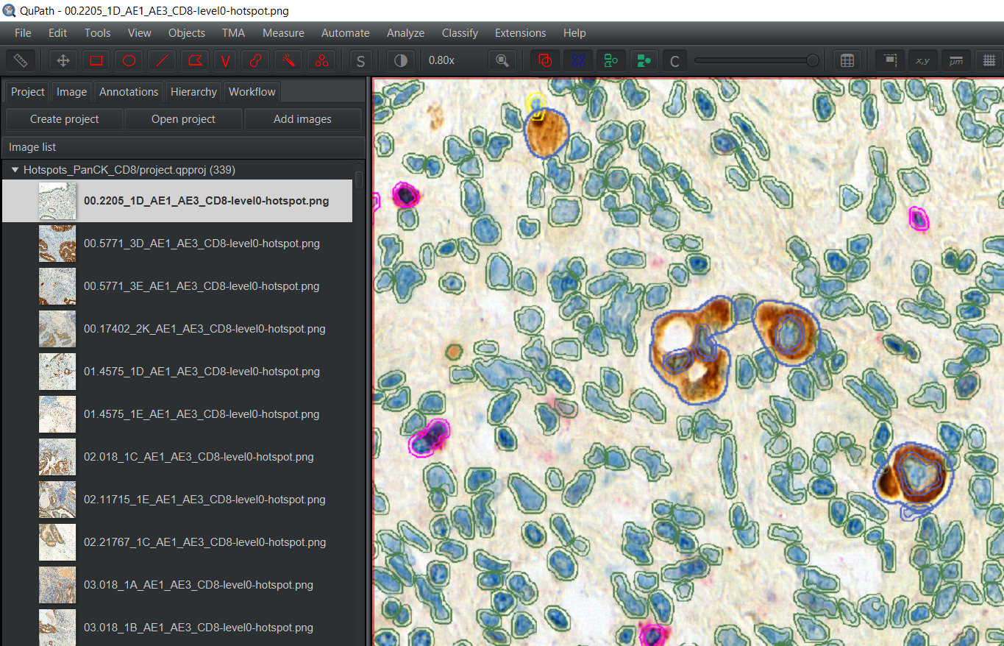
qupath
Tumor buds (brown spot)
Bounded by polygons
+ Extra information : area, center of mass, …
=> Stored in the JSON file
Notes:
Explain purpose of QuPath : software to visualize particular region. Tumor, Cells, bounded by polygons. Also we have some information about each cells like perimeter, area, center of mass, …

Slide 8
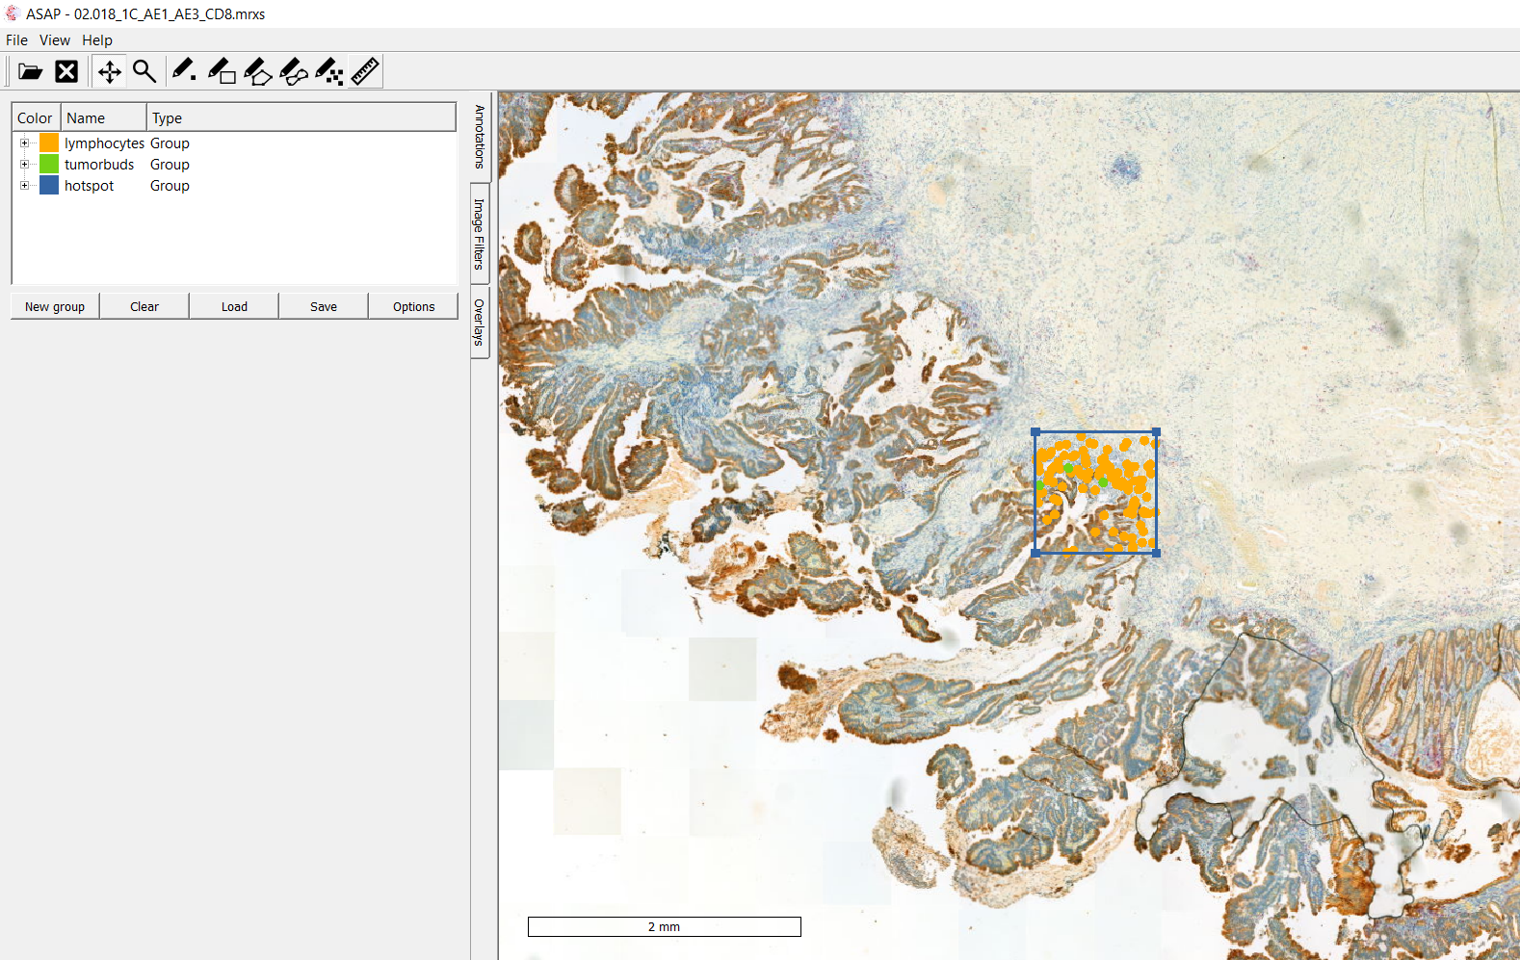
Asap
Visualisation using XML file to drawn annotations on whole slide image or TMA
Notes:
Second software asap to use xml file in order to see on a full medical picture a particular hotspot, xml file used for phd project, whole slide image -> tumor budding hotspot

Slide 9
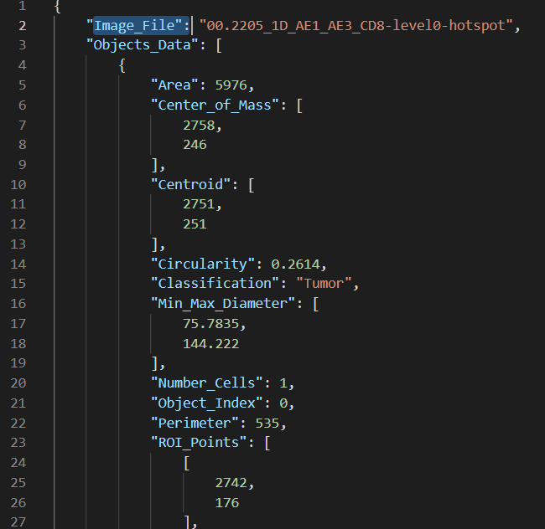
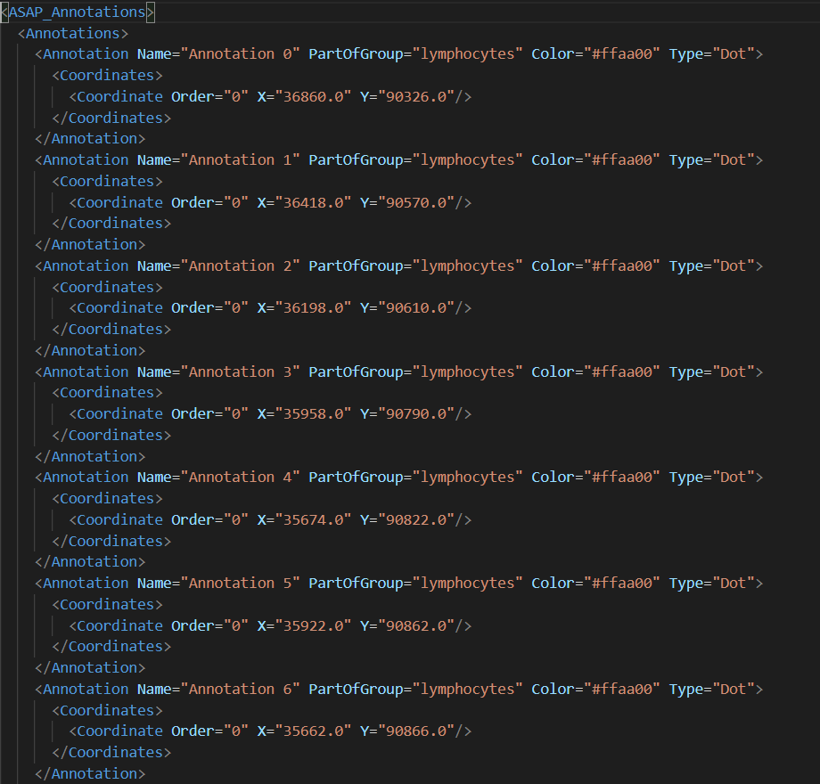
DAtA processing
JSON file (from QuPath)
XML file (coordinates)
Python Script
Notes:
Goal of the project, transform json file where we can fin information

Slide 10



Data processing
Conversion 1: JSON (+XML) to XML for drawing annotations on ASAP on the whole slide image
Annotations
Hotspot coordinates

Slide 11
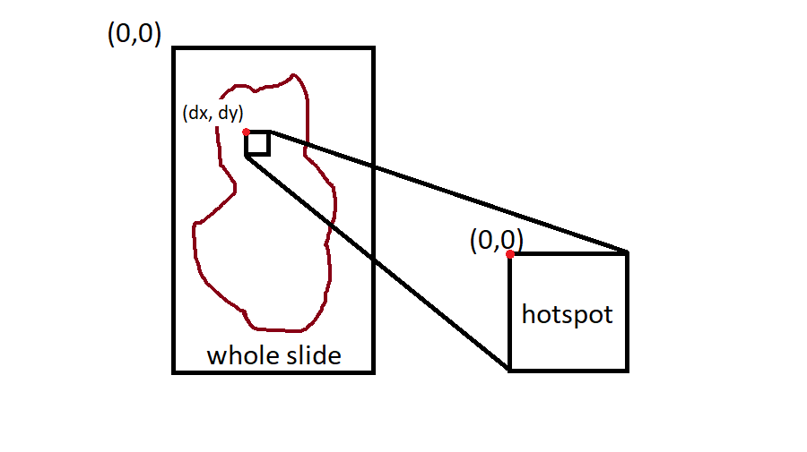
Resolution
Open JSON file
Read each ROI points (X, Y)
Open XML file
Read the offset (dx, dy)
For each ROI points, shift the coordinates: (X + dx, Y + dy)
Write the new coordinates into the XML output file

Slide 12
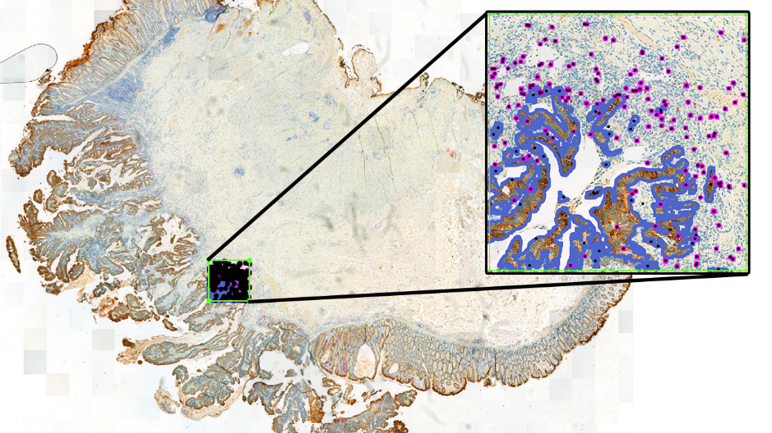
result

Slide 13
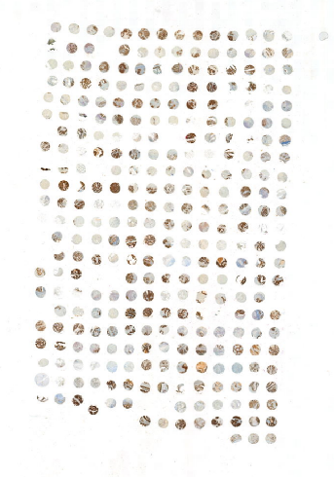

Conversion 1: JSON (+CSV) to XML for drawing annotations on ASAP on the tissue micro array
Center of hotspot coordinates & radius
Annotations

Slide 14
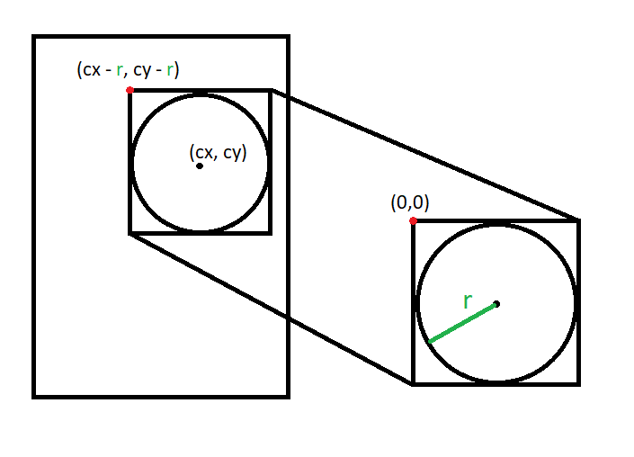
resolution
Open JSON file
Read each ROI points (X, Y)
Open CSV file
Read the center coordinates (cx, cy) and the radius r
For each ROI points, shift the coordinates: (X + cx - r, Y + cy - r)
Write the new coordinates into the XML output file

Slide 15
DATA PROCESSING
conv 1: JSON -> XML (whole slide image)

Slide 16

excel
JSON file to .CSV
Containing other features:
Perimeter, area, …
Python Script
Notes:
Second part : convert json file in .csv file in order to visualize data on an excel sheet, other features

Slide 17
Questions ?

